Slide 1
The Allergy and Asthma Expert

Slide 2
Allergic disease affects about 70 million Americans
Nearly 20-25 percent of U.S. population suffers from:
Asthma
Allergic rhinitis
Sinus infections
Eye allergies
Skin allergies
Food allergies
Insect allergies
Anaphylaxis
U.S. Population:
338 million

Slide 3
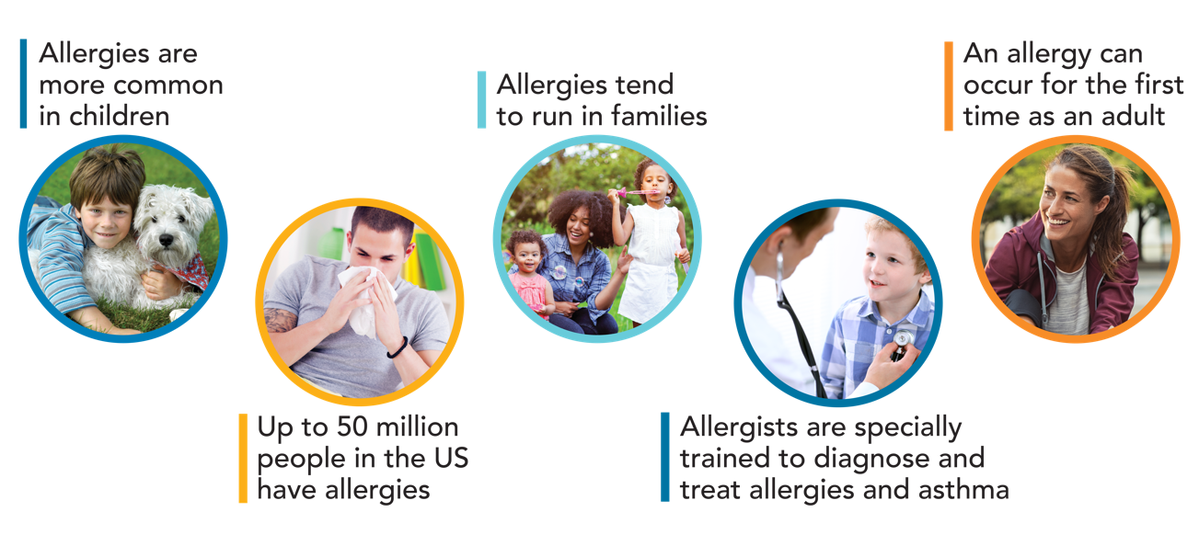
Facts About Allergies

Slide 4

Misdiagnosis and mistreatment
can be dangerous.
But it doesn’t need to happen,
and it shouldn’t happen.
Allergists are specially trained to treat asthma and allergies and keep these patients as healthy as possible.

Slide 5

Potential risks of non-specialist care
Misinterpretation of test results
Over-diagnosis
Mismanagement
Over-prescription of medications
and treatments
Costly and unnecessary allergen avoidance

Slide 6



Anyone with allergies and asthma should expect to:
Feel good
Be active all day
Sleep well at night
No one should accept less.

Slide 7

Allergists are Allergy and Asthma Specialists
Qualifications:
  Medical degree
  Three-year residency training in Internal Medicine or Pediatrics or four-year residency in Med-Peds
  Additional two or three years of intensive training in an Allergy and Immunology Fellowship
  Board certification in Allergy & Immunology

Slide 8

Board-certified allergists have specialized training to expertly:
Perform allergy testing.
Identify the source of suffering.
Diagnose allergic conditions and asthma.
Treat more than just symptoms.
Develop a plan for each patient that eliminates symptoms and prepares for severe reactions or flares.
Safely administer therapy and medications.
Monitor patients’ progress over time and adjust treatment as needed.
Provide most cost-effective care and outcomes.

Slide 9
Allergists have special training and education in medical treatment for allergies and asthma
New medications and treatments are approved every year for allergic conditions ranging from hay fever to eczema to food allergy to asthma.
Allergists keep up with new developments in the science and treatment of these conditions through professional education meetings, online learning, and through notifications and treatment guidelines from their professional organizations.
Some of the available treatments include allergy shots (immunotherapy); corticosteroids; topical treatments; and, for more severe symptoms, biologics – a newer class of drugs that can improve many allergic conditions. For many patients, multiple conditions can be addressed with the same medication.

Slide 10

What to expect from allergist care
Evaluation
  Medical history
  Physical exam
  Testing (allergy and breathing)
Education and management plans for prevention
  Environmental modifications and allergen/trigger avoidance
  Self-management plans
  Emergency action plans for asthma or severe allergic reactions
Partnerships with other health care providers and caregivers
Treatment, including allergy shots (immunotherapy) and biologics

Slide 11



Allergist care results in:
Greater satisfaction with care.
Improved quality of life.
Better outcomes.
Lower costs.

Slide 12
How common is it to find relief after seeing an allergist?
Up to 90% of patients with seasonal allergies find relief.
Up to 80% with year-round allergies find relief.

Slide 13

Research shows asthma patients cared for by allergists have:
Fewer emergency care visits.
Fewer hospitalizations.
Reduced lengths of hospital stays.
Fewer sick care office visits.
Fewer days missed of work and school.

Slide 14

Specialist treatment saves healthcare costs.
Less time at the doctor,
in the ED or the hospital
saves healthcare dollars

Slide 15


Improved asthma outcomes
A growing body of evidence demonstrates that allergist care improves outcomes for asthma patients, with better symptom control, fewer severe episodes, and improved adherence to medications.
This means that patients are significantly more able to enjoy activities, attend work, and have an overall improved quality of life. It also means less cost to both patients and the health care system.

Slide 16

National government guidelines recommend specialist care if patient:
Has asthma symptoms every day and often at
night that limit activity.
Has had a life-threatening asthma attack.
Does not meet asthma treatment goals after three
to six months or doesn’t respond to treatment.
Has unusual or hard to diagnose symptoms.
Has other conditions such as severe hay fever or
sinusitis that complicate asthma or make it hard to diagnose.
Needs more tests to find out what causes symptoms.

Slide 17

National government guidelines recommend specialist care if patient (continued):
Needs more instruction on a treatment plan, medicines
or asthma triggers.
Might be helped by allergy shots.
Needs treatment with a medicine called oral
corticosteroids or have used this medicine more
than twice in one year.
Has stayed in the hospital because of asthma.
Needs help to identify asthma triggers.
Has questions about an asthma diagnosis.

Slide 18


Feel good.
Be active all day.
Sleep well at night.
Find an allergist, find relief.
Find an Allergist and other useful tools at AllergyAndAsthmaRelief.org

