Slide 1
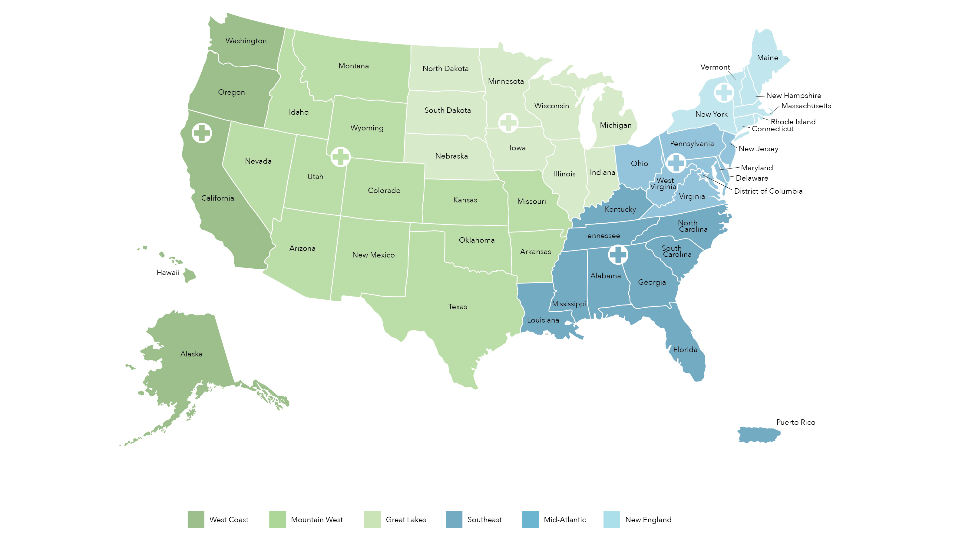
Great Lakes
Super Delegate: Don Bukstein, MD
IL – Eugenia Hahn, MD
IN – Neha Yakhmi, MD
MI – Ridhu Burton, MD
MN – Thomas Helm, MD
NE – Linda Ford, MD
WI – Todd Mahr, MD
IA, ND, SD - Apply March 15, 2026
West Coast
Super Delegate: Greg Bensch, MD
AK – Kristina James, MD
CA – Sheila Bonilla, MD
OR – Shyam Joshi, MD
HI, WA - Apply March 15, 2026
New England
Super Delegate: Russell Settipane, MD
CT – Kevin McGrath, MD
ME – Paul Shapiro, MD
MA – Jonathan Bayuk, MD
NY – Purvi Parikh, MD
RI – Russell Settipane, MD
NH, VT – Apply March 15, 2026
Mountain West
Super Delegate: Michael Volz, MD
AZ – Michael Manning, MD
AR – Tina Merritt, MD
CO – Daniel Soteres, MD
ID – Neetu Talreja, MD
KS – Jay Portnoy, MD
MO – Jeremy Katcher, MD
MT – Carl Thornblade, MD
NV – Jason Bellak, MD
NM – Michael Rupp, MD
OK – Aisha Mohammed, MD
TX – Vivek Rao, MD
UT – Douglas Jones, MD
WY - Apply March 15, 2026
Mid-Atlantic
Super Delegate: Michael Palumbo, MD
MD – Rachel Schreiber, MD
NJ – Lisa Barisciano, MD
OH – Ahmed Elisa, MD
PA – Sigrid DaVeiga, MD
VA – Srinagesh Paluvoi, MD
WV – Meagan Shepherd, MD
DE - Apply March15, 2026
Southeast
Super Delegate: Joseph Forester, MD
AL – Joseph Forester, MD
FL – Shahnaz Fatteh, MD
GA – Melinda Rathkopf, MD
KY – J. Wesley Sublett, MD
LA – David Kaufman, MD
MS – Charles Grogan, MD
NC – Joel Gallagher, MD
SC, TN - Apply March 15, 2026

