Slide 1
Penicillin Allergy Identification and Delabeling for the Primary Care Clinician
Last updated: February 2026

Slide 2
Roadmap
Introduction
Penicillin Allergy in Children
Penicillin Allergy Identification
Proactive Low-risk Penicillin Allergy Delabeling in Your Clinic
Low-risk Penicillin Allergy Delabeling Clinic Must Haves
True Penicillin Allergy- What Next?

Slide 3
Introduction

Slide 4

Penicillin Allergy Label: >32 Million in US and counting

Slide 5
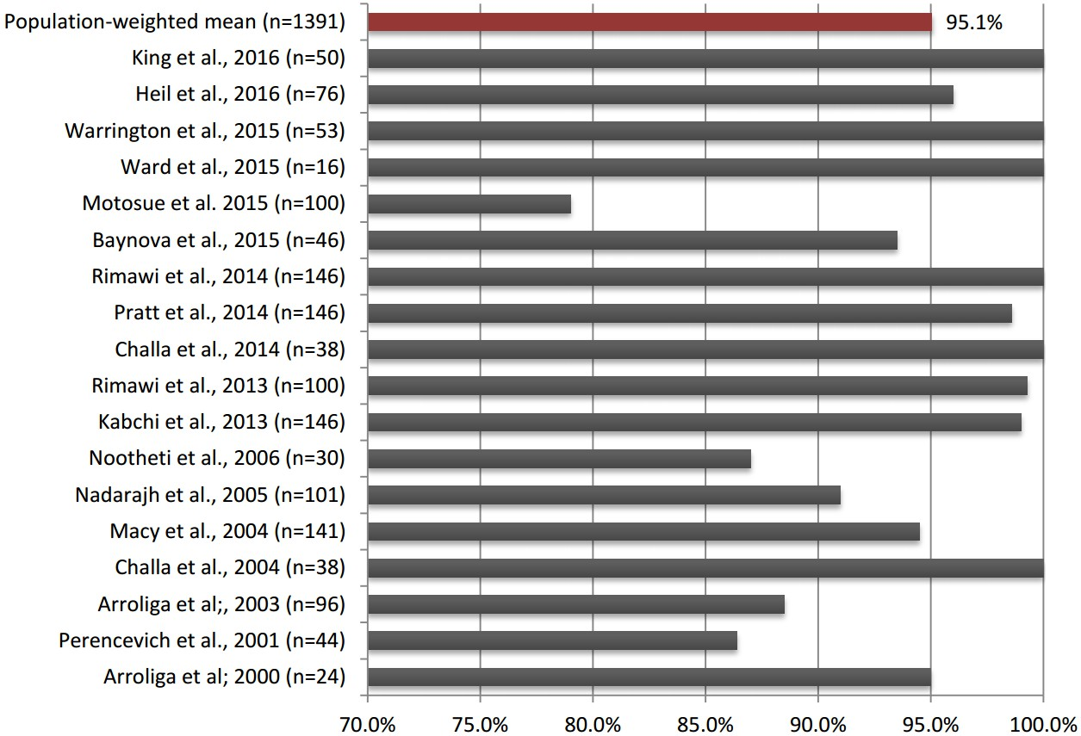
95% Are Not Truly Allergic
Sacco KA, et al. Allergy. 2017 Sep;72(9):1288-1296.

Slide 6
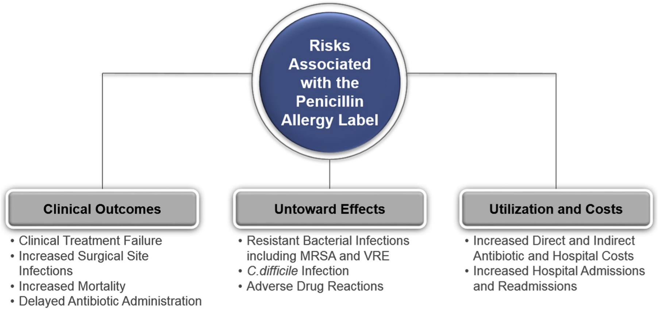
Why the “Allergy Label” Matters
Staicu ML, et al. J Allergy Clin Immunol Pract. 2020 Oct;8(9):2858-2868.e16.

Slide 7






You Have Support!

Slide 8
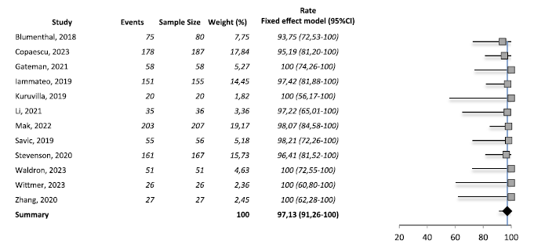
Safety in Adult Delabeling: Meta Analysis
Successful delabeling rate of 97.13%
Stul F, et al. J Allergy Clin Immunol Pract. 2024 Sep;12:2415-26
Notes:
FIGURE 2. Forest plot: rate of successful delabeling, outcome: no hypersensitivity reaction to dDC. Events: successful delabeling or no
reaction to dDC. Heterogeneity: Q(c2) ¼ 0.36, df ¼ 11 (P > .2), and I2 ¼ 0%.39-46,54-57 CI, Confidence interval; dDC, direct drug
challenge.

Slide 9
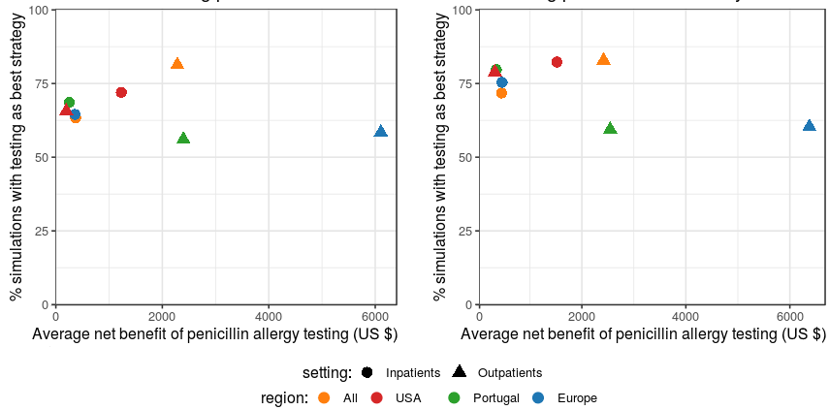
Cost Savings
Skin Testing & Drug Challenge Testing: Savings $554 for inpatients and $2,745 for outpatients
Drug Challenge Testing Alone:
Savings of $616 for inpatients and
$3,051 for outpatients
Sousa-Pinto B, et al. Clinical Infectious Diseases. 2020; Volume 849, page 30.

Slide 10
Penicillin Allergy in Children

Slide 11
The Pediatric Difference: Penicillin Allergy
Children more commonly have viral exanthems in the penicillin antibiotic course that may appear similar to drug hypersensitivity reactions¹
Estimated 75% of children with reported penicillin allergy are diagnosed by 3 years²
Skin testing is painful for children and can have limited diagnostic value pending clinical history³
¹ Caubet, et al. J Allergy Clin Immunol. 2011 Jan; 127(1):218-22.
² Stone, et al. Allergy. 2020 Feb; 75(2):273–88.
³ Gomes, et al. Allergy. 2016 Feb; 71(2):149-61.

Slide 12
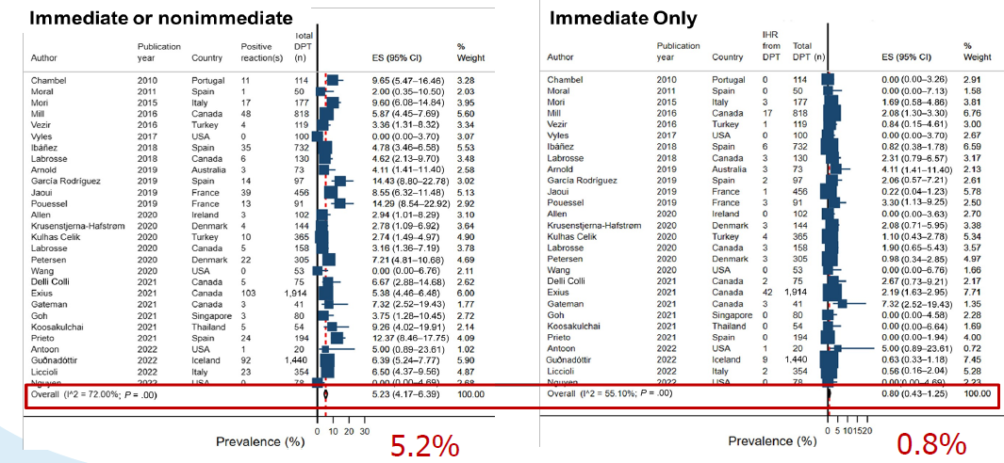
Safety in Children Delabeling: Meta Analysis
Successful delabeling rate of 94.8%
Srisuwatchari et al. J Allergy Clin Immunol Pract. 2023 Feb; 11(2):506-518.
Notes:
The estimated pooled prevalence of beta-lactam (BL) drug allergy confirmed by direct DPT in children.

Slide 13
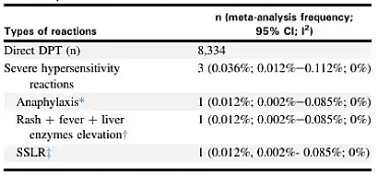
Safety in Children Delabeling: 28 Studies Meta Analysis
Total of 0.036% severe reactions
Srisuwatchari et al. J Allergy Clin Immunol Pract. 2023 Feb; 11(2):506-518.

Slide 14
Penicillin Allergy Identification

Slide 15
Defining a Penicillin Antibiotic
Penicillin G (Pfizerpen) or Penicillin G benzathine (Bicillin L-A)
Penicillin V potassium (Pen-VK)
Nafcillin
Oxacillin
Cloxacillin
Dicloxacillin (Dycill)
Ampicillin
Amoxicillin (Amoxil, Moxatag)
Amoxicillin-Clavulanate (Augmentin, Amoclan)
Ampicillin-Sulbactam (Unasyn)
Piperacillin-Tazobactam (Zosyn)
Monobactams, such as Aztreonam, are beta lactam antibiotics with no cross-reactivity with penicillin antibiotics

Slide 16
Penicillin Allergy Reaction- Signs and Symptoms
Cutaneous and Mucosal
Immediate: urticaria, angioedema, pruritus, rhinitis, conjunctivitis
Delayed: morbilliform, maculopapular, target lesions, pustular, exfoliative, bullous
Cardiovascular
Hypotension, tachycardia
Respiratory
Cough, dyspnea, wheezing, stridor, laryngeal edema, and/or hypoxia
Neurologic
Confusion, loss of consciousness, seizures
Hematologic and organ involvement
Eosinophilia
Drug-induced liver disease (DILI)
Gastrointestinal
Sudden gastrointestinal symptoms, associated with other systemic symptoms
Isolated GI symptoms (nausea, vomiting, abdominal pain, diarrhea) are not consistent with allergic drug reaction

Slide 17
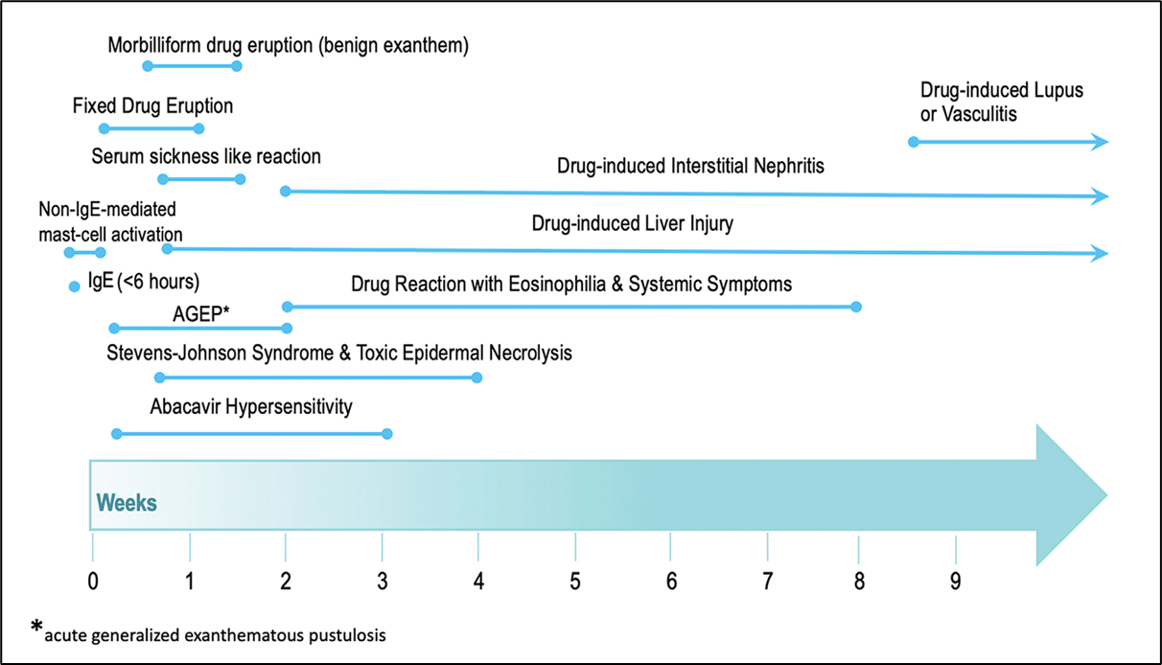
Reaction Timing
Khan DA, et al. J Allergy Clin Immunol. 2022 Dec;150(6):1333-1393.

Slide 18
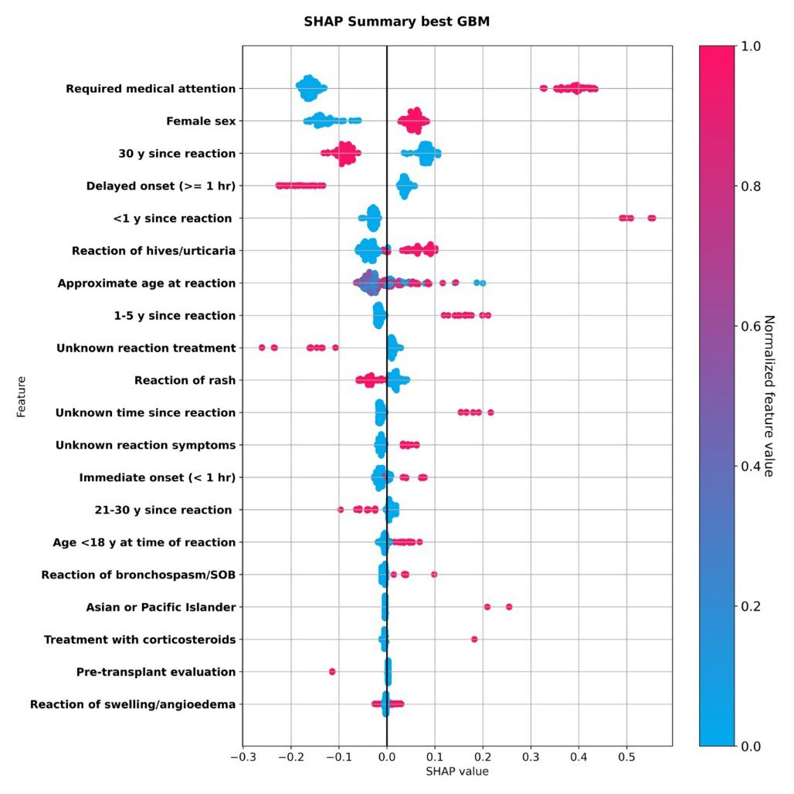
Reaction History Positive Drivers
Required medical attention
Less than 1 year since the reaction
Hives/urticaria
Underpowered in prior prediction studies to distinguish hives from other rashes
1:1:1 criterion for urticaria suggests some are high risk
Gonzalez-Estrada A, et al. J Allergy Clin Immunol Pract. 2024 May;12(5):1181-1191.e10.

Slide 19
Practice Parameter Update: Penicillin Allergy
Consensus Based Statement | Strength of Recommendation | Certainty of Evidence
We recommend against testing in patients with a history inconsistent with penicillin allergy (such as headache or family history of penicillin allergy), but a 1-step amoxicillin challenge may be offered to patients who are anxious or request additional reassurance to accept the removal of a penicillin allergy label. | Strong | Moderate
We suggest penicillin skin testing for patients with a history of anaphylaxis or a recent reaction suspected to be IgE mediated. | Conditional | Low
Khan DA, et al. J Allergy Clin Immunol. 2022 Dec;150(6):1333-1393.

Slide 20
Practice Parameter Update: Penicillin Allergy
Consensus Based Statement | Strength of Recommendation | Certainty of Evidence
We recommend against penicillin skin testing prior to direct amoxicillin challenge in pediatric patients with a history of benign cutaneous reaction (such as maculopapular rashes and urticaria). | Strong | Moderate
We suggest that direct amoxicillin challenge be considered in adults with distant and benign cutaneous reaction histories (such as maculopapular rashes and urticaria). | Conditional | Low
Khan DA, et al. J Allergy Clin Immunol. 2022 Dec;150(6):1333-1393.

Slide 21
Proactive Low-risk Penicillin Delabeling

Slide 22
Low-risk Penicillin Allergy Patient Selection
Patient labeled with a penicillin and/or penicillin derivative drug allergy presents to clinic visit for any reason
Drug allergy labels confirmed through routine screening by primary care clinic technician/nurse
If a penicillin and/or penicillin derivative drug allergy is reported by the patient and/or identified by the technician, the technician will provide patient with the Primary-care Led Amoxicillin Challenge (PLAC) or PEN-FAST screening tool pending clinic preference and age of patient
Patient completes screening tool while awaiting clinic visit and gives to physician/provider during visit

Slide 23
Primary care Led Amoxicillin Challenge (PLAC) Screening Tool
Following the reaction, have you since taken and tolerated a penicillin or a penicillin derivative (such as Amoxicillin, Augmentin, etc.)? |  | YES | NO
P | Did your reaction occur within the past year? | YES | NO
L | Was your reaction life-threatening (i.e. requiring epinephrine, emergency room visit, hospitalization, and/or intubation)? | YES | NO
A | Did your reaction involve any symptoms other than a rash, such as: swelling (eyes, lips, tongue), shortness of breath, wheezing, repetitive cough, hoarseness, trouble breathing, trouble swallowing, vomiting, crampy abdominal pain, diarrhea, dizzy, confused? If unknown, mark NO. | YES | NO
C | Did you have a complicated reaction involving blistering, ulceration, sloughing/peeling of your skin or lining of your mouth, eyes, genitals - OR - involved any organ dysfunction/failure? | YES | NO
If Question #1 is “YES”, STOP, the patient has been cleared.
If Question #1 is “NO” and all PLAC Questions are “NO,” patient has the “green light” and is a candidate for challenge in primary care clinic
If Questions L and/or A is “YES”, consider referral to Allergy/Immunology if frequent antibiotic use or other indication to de-label penicillin allergy.
If Question C is “YES” the patient is not a candidate for testing or induction of tolerance
Mari DM, Steigelman DA, White, KM (Aug 2025). Moving Forward with General Pediatric Led Penicillin Allergy Delabeling. Curr Treat Options Peds, (in review).

Slide 24
PLAC Low-risk Delabeling Candidate Examples
Following the reaction, have you since taken and tolerated a penicillin or a penicillin derivative (such as Amoxicillin, Augmentin, etc.)? |  | YES | NO
P | Did your reaction occur within the past year? | YES | NO
L | Was your reaction life-threatening (i.e. requiring epinephrine, emergency room visit, hospitalization, and/or intubation)? | YES | NO
A | Did your reaction involve any symptoms other than a rash, such as: swelling (eyes, lips, tongue), shortness of breath, wheezing, repetitive cough, hoarseness, trouble breathing, trouble swallowing, vomiting, crampy abdominal pain, diarrhea, dizzy, confused? If unknown, mark NO. | YES | NO
C | Did you have a complicated reaction involving blistering, ulceration, sloughing/peeling of your skin or lining of your mouth, eyes, genitals - OR - involved any organ dysfunction/failure? | YES | NO
If Question #1 is “YES”, STOP, the patient has been cleared.
Mari DM, Steigelman DA, White, KM (Aug 2025). Moving Forward with General Pediatric Led Penicillin Allergy Delabeling. Curr Treat Options Peds, (in review).

Slide 25
PLAC Low-risk Delabeling Candidate Examples
Following the reaction, have you since taken and tolerated a penicillin or a penicillin derivative (such as Amoxicillin, Augmentin, etc.)? |  | YES | NO
P | Did your reaction occur within the past year? | YES | NO
L | Was your reaction life-threatening (i.e. requiring epinephrine, emergency room visit, hospitalization, and/or intubation)? | YES | NO
A | Did your reaction involve any symptoms other than a rash, such as: swelling (eyes, lips, tongue), shortness of breath, wheezing, repetitive cough, hoarseness, trouble breathing, trouble swallowing, vomiting, crampy abdominal pain, diarrhea, dizzy, confused? If unknown, mark NO. | YES | NO
C | Did you have a complicated reaction involving blistering, ulceration, sloughing/peeling of your skin or lining of your mouth, eyes, genitals - OR - involved any organ dysfunction/failure? | YES | NO
If Question #1 is “NO” and all PLAC Questions are “NO,” patient has the “green light” and is a candidate for challenge in primary care clinic
Mari DM, Steigelman DA, White, KM (Aug 2025). Moving Forward with General Pediatric Led Penicillin Allergy Delabeling. Curr Treat Options Peds, (in review).

Slide 26
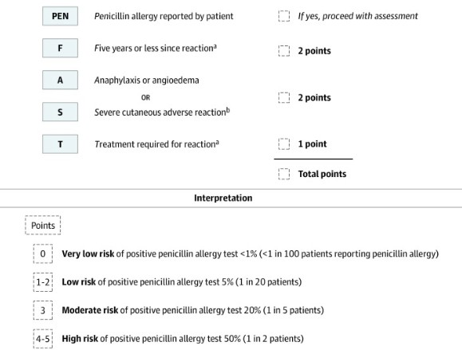
PEN FAST for >12 years
Performs well at the extremes (1 and 5 scores)
Validated for those >12 years
Recommend PEN FAST = 0 should be low-risk for primary care
Need a higher sensitivity tool
Trubiano JA, et al. JAMA Intern Med. 2020 May 1;180(5):745-752.
Copaescu AM, et al. JAMA Netw Open. 2022 Sep 1;5(9):e2233703.

Slide 27
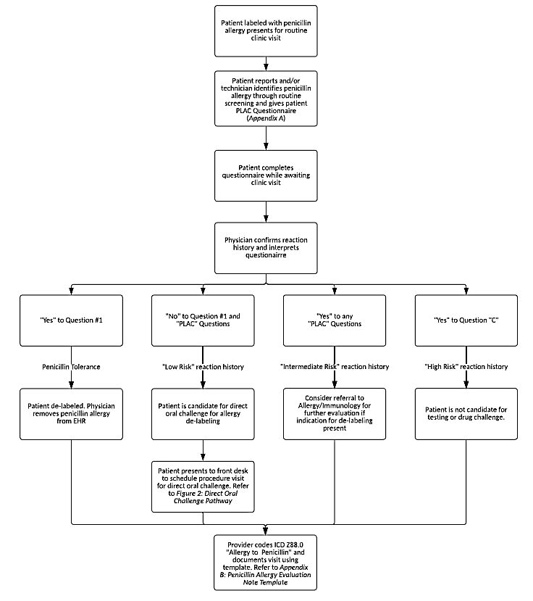
Penicillin Delabeling Candidate Pathway
*
Figure 1. Low-risk penicillin delabeling candidate pathway.

Slide 28
Low-risk Penicillin Allergy Prediction Tools
Current tools risk-stratify penicillin administration outcomes in penicillin allergic labeled patients.
But there is no one validated low risk penicillin allergy delabeling tool for every patient.
Ghiordanescu IM, et al. J Allergy Clin Immunol Pract. 2024 Nov;12(11):2985-2993.

Slide 29
Contraindications to Direct Oral Challenge in Primary Care Clinic
Life-threatening allergic reaction to penicillin and/or penicillin derivative requiring epinephrine, emergency room visit, hospitalization, and/or intubation.
Reaction involving skin blistering, ulceration, sloughing of skin or lining of mouth, eyes, or genitals.
Reaction resulting in Stevens-Johnson Syndrome or Toxic Epidermal Necrolysis.
Reaction involving any organ dysfunction/failure.
Reaction resulting in Serum Sickness, Drug Reaction with Eosinophilia (DRESS), or Acute Interstitial Nephritis.
On antihistamine therapy (should be off all antihistamines at least 3 days prior to direct oral challenge).

Slide 30
Low-risk Direct Oral Challenge Protocol
Low-risk candidate(s) presents 15 minutes early for direct oral challenge.
Obtain a full set of vital signs for each patient upon initial screening.
Physician/provider will obtain consent(s) will be signed and scanned into EMR.
Physician/provider to ensure “low risk” reaction history.
Physician/provider will perform basic cardiopulmonary and skin exam.
After completion of above, give patient(s) Amoxicillin 250 mg.
Observe patient(s) for 1 hour after ingestion of Amoxicillin.
Observation is a passive process where a team member is in the room and/or immediately available but not actively evaluating the patient(s).

Slide 31
Low-risk Direct Oral Challenge Protocol
After 1 hour of observation is complete, a repeat set of vital signs and physical examination.
If the patient develops no significant reaction during observation, the patient is delabeled of the previous penicillin/penicillin derivative drug allergy.
Physician/provider will subsequently remove this allergy from EMR.

Slide 32
Low-risk Direct Oral Challenge Protocol
If the patient develops an allergic reaction during observation, the physician/provider will evaluate and treat the reaction.
If reaction is consistent with anaphylaxis, administer epinephrine (0.3 mg for patients >25 kg and 0.15 mg for patients ≤25 kg) intramuscularly via epinephrine auto-injector
Consider transfer the patient to the facility’s higher level of care for urgent or emergent treatment and observation pending reaction severity.
Document encounter and code for procedure visit with E/M code 99212-92215 “Established Patient Visit” with 25 modifier and CPT 95076 “Ingestion Challenge Test, Initial 120 minutes”.

Slide 33
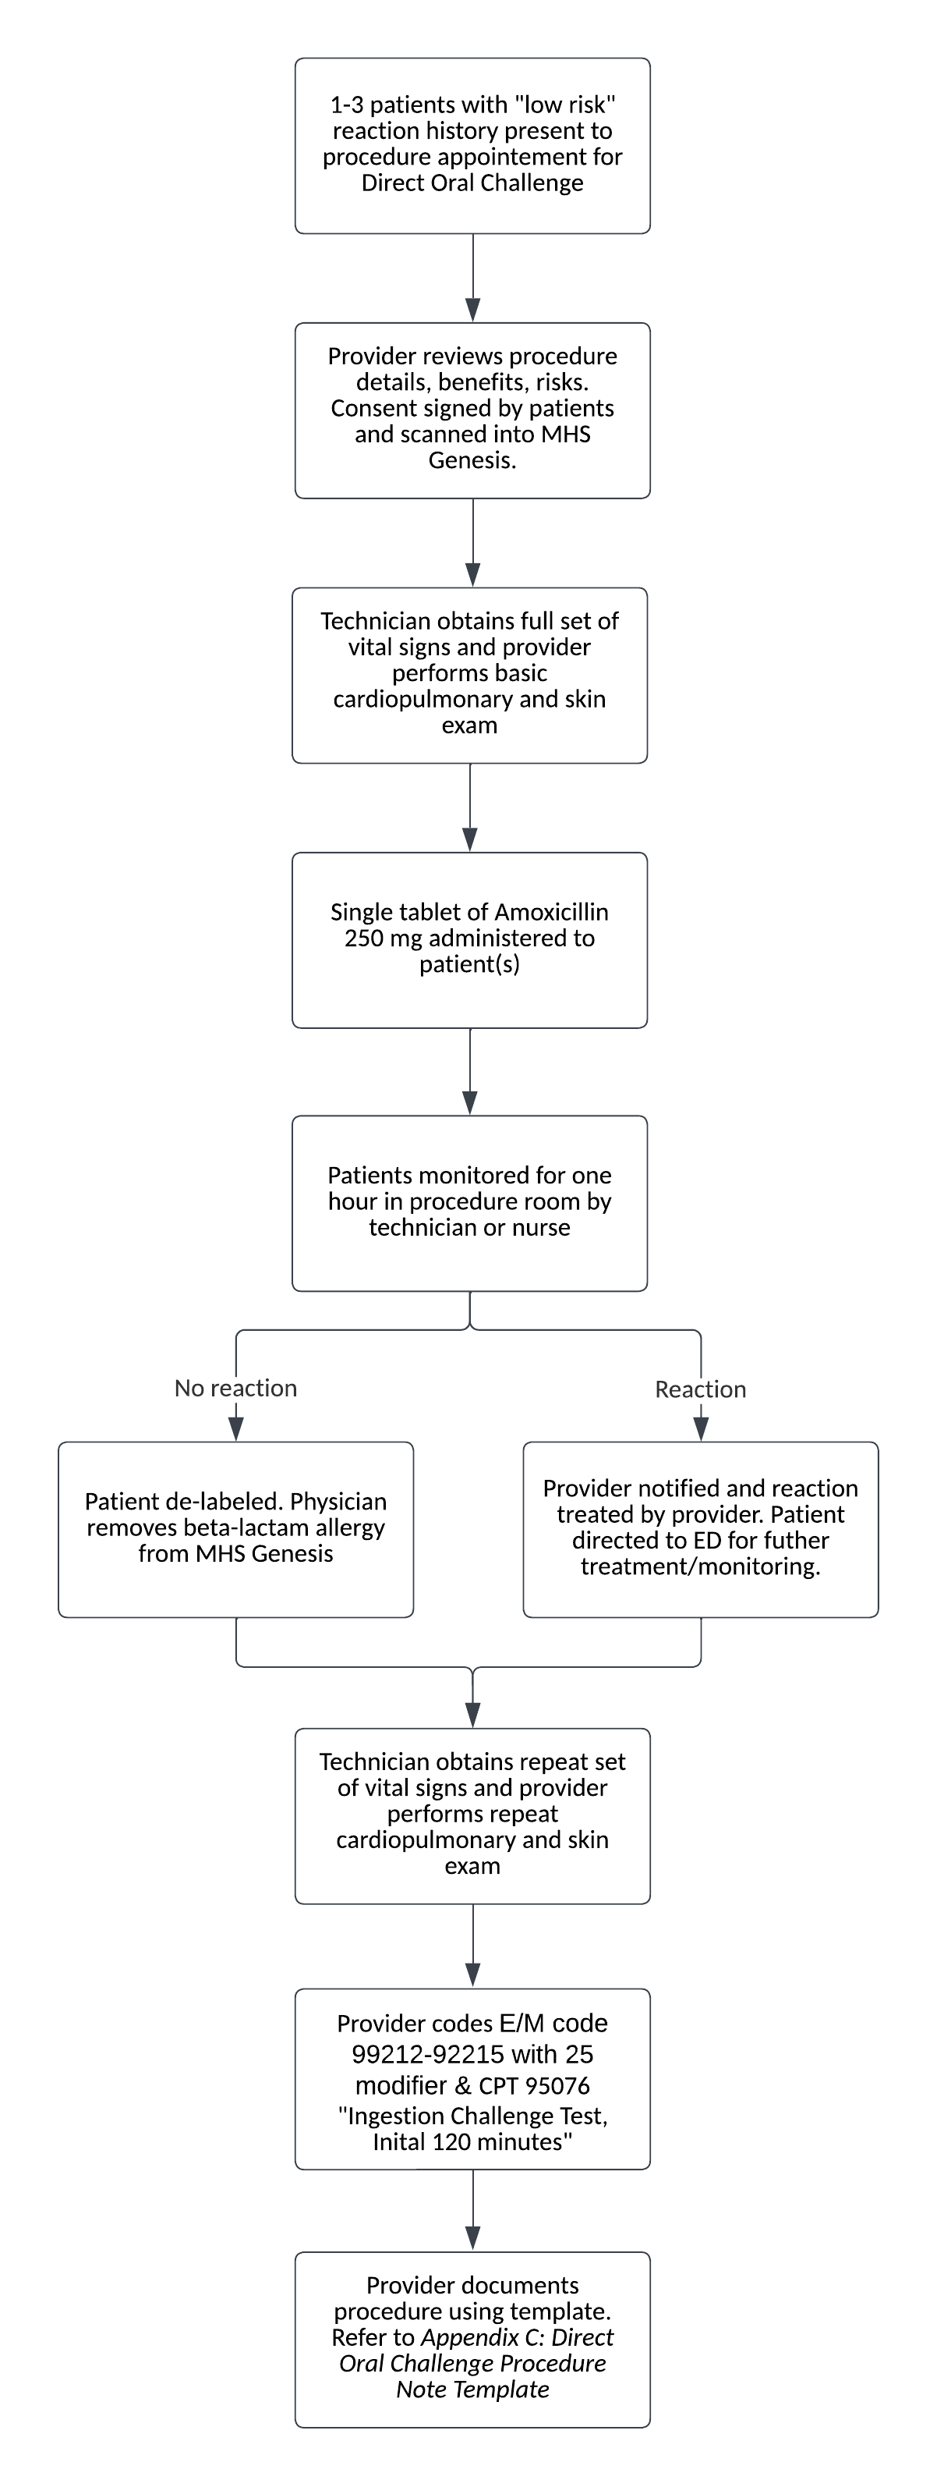
Figure 2. Low-risk direct oral amoxicillin challenge pathway.

Slide 34
Low-risk Penicillin Delabeling Clinic Resources

Slide 35
Target Patient Population
All patients empaneled in:
Pediatrics
Internal Medicine
Family Medicine
OB/GYN
Pregnant women with low-risk symptoms.
If moderate symptoms, penicillin skin testing should be done in the third trimester by an allergy specialist.
If allergy history includes anaphylaxis or a severe cutaneous adverse reaction, penicillin allergy evaluation is not recommended in pregnancy.

Slide 36
Roles and Responsibilities
Physicians/providers:
Ensure familiarity with protocols. Perform and supervise penicillin allergy evaluation and low-risk penicillin allergy delabeling. Communicate deviations from protocol and safety concerns resulting from implementation of chosen protocol with clinic leadership.
Nursing:
Maintain familiarity with this protocol. Obtain medications required for direct oral challenge procedure and supervise patients completing direct oral challenges in accordance with chosen protocol.
Pharmacists:
Maintain familiarity with this protocol. Stock and provide medications required for direct oral challenge procedure. Ensure medications are dosed correctly, labeled, and non-expired.

Slide 37
Roles and Responsibilities
Medical Assistants:
Maintain familiarity with this chosen protocol. Identify patients with penicillin allergy label during clinic screening and distribute low risk penicillin allergy screening tool to patients with instructions to complete while awaiting clinic visit. Obtain medications required for direct oral challenge procedure and supervise patients completing direct oral challenges.
Front Desk Staff:
Maintain familiarity with chosen clinic protocol. Assist with scheduling low risk patients for procedure clinic visits for direct oral challenge for penicillin allergy delabeling and provide patients with pre-procedure instructions sheet.

Slide 38
Medications Required for Delabeling
Amoxicillin 250 mg tablets (for adults) and 5 mL of 250mg/5mL stock liquid solution (for children) that will be used for direct oral challenge.
At least two non-expired epinephrine autoinjector sets (0.15 mg and 0.3 mg) for treatment of allergic reactions (0.3 mg for patients >25 kg and 0.15 mg for patients ≤25 kg).
Alternatively, can have two non-expired Neffy sets (1 mg and 2 mg) for treatment of allergic reactions (Neffy 1 mg for those ≥ 4 years weighing 33 lbs to <66 lbs and Neffy 2 mg for those ≥ 4 years who weigh ≥66 lbs).

Slide 39
True Penicillin Allergy- What Next?

Slide 40
Practice Parameter Update: Penicillin Allergy
Consensus Based Statement | Strength of Recommendation | Certainty of Evidence
We suggest that for patients with an unverified non-anaphylactic penicillin allergy, a cephalosporin can be administered without testing or additional precautions. | Conditional | Moderate
We suggest that for patients with a history of anaphylaxis to penicillin, a non-cross- reactive cephalosporin can be administered without prior testing. | Conditional | Moderate
Khan DA, et al. J Allergy Clin Immunol. 2022 Dec;150(6):1333-1393.

Slide 41
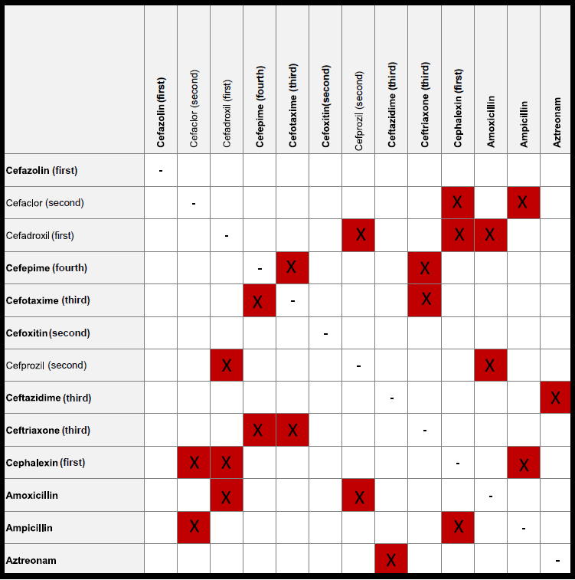
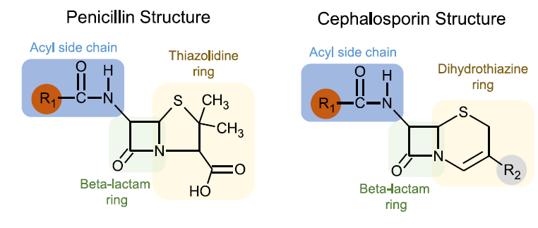
Immediate allergic reactions to cephalosporins are based primarily on side chain.
<2% risk of reaction to a cephalosporin with penicillin allergy.
Cefazolin and 3rd-5th generation cephalosporins are safe even in patients with confirmed penicillin allergy.
Khan DA, et al. J Allergy Clin Immunol. 2022 Dec;150(6):1333-1393.

Slide 42
Penicillin Desensitization
Desensitization is performed when patient has confirmed penicillin allergy and there is NO ACCEPTABLE TREATMENT ALTERNATIVE
An example can be a pregnant women with syphilis or someone with tertiary neurosyphilis
Desensitization must be performed under supervision/consult with a trained allergist
Desensitization induces a TEMPORARY TOLERANCE, and those patients still maintain there underlying penicillin allergy
Temporary effects that last for at least two dosing intervals, after which desensitization needs to be repeated
DO NOT perform desensitization on patients with history of serum sickness, SJS.TEN, and DRESS.
Castells. Immunol Allergy Clin North Am. 2009 Aug;29(3):585-606.

Slide 43
Conclusion

Slide 44
Penicillin Allergy Labels
Identify
Evaluate
Low-risk challenges in the primary care clinic
If not low-risk, refer to Allergy
Alternatives
If true penicillin allergy, patient can receive Cefazolin or 3rd-5th generation cephalosporins safely without additional testing.
Consider special circumstances and barriers

Slide 45
Thank you!
This presentation was developed by the ACAAI Drug Allergy Committee.
We thank the following workgroup members for their contributions:
David Mari, DO
Prarthana Patel, MD
Shirley Jiang, MD

