Slide 1
The Allergy and Asthma Expert

Slide 2
Allergic disease affects about 50 million Americans
Nearly 20-25 percent of U.S. population suffers from:
Asthma
Allergic rhinitis
Sinus infections
Eye allergies
Skin allergies
Food allergies
Insect allergies
Anaphylaxis
U.S. Population:
331 million

Slide 3
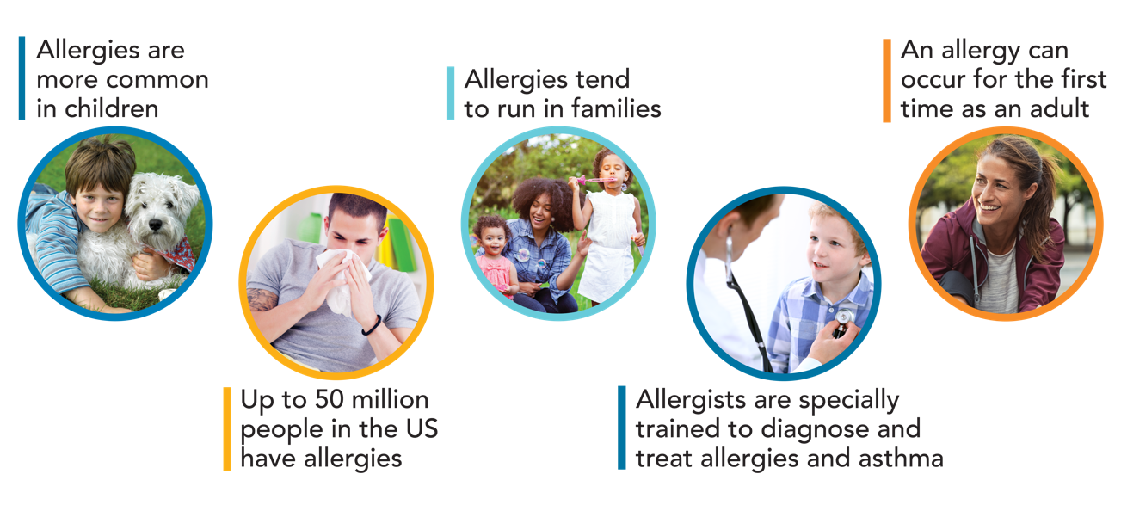
Facts About Allergies

Slide 4
Misdiagnosis and mistreatment can be dangerous.
But it doesn’t need to happen,
and it shouldn’t happen.
Allergists are specially trained to treat asthma and allergies and keep these patients as healthy as possible.

Slide 5
Potential risks of non-specialist care
Misinterpretation of test results
Over-diagnosis
Mismanagement
Over-prescription of medications and treatments
Costly and unnecessary allergen avoidance

Slide 6
Anyone with allergies and asthma should:
Feel good.
Be active all day.
Sleep well at night.
No one should accept less.

Slide 7
Allergists are Allergy and Asthma Specialists
Qualifications:
Medical degree
Three-year residency training in Internal Medicine or Pediatrics or four-year residency in Med-Peds
Additional two or three years of intensive training in an Allergy and Immunology Fellowship
Board certification in Allergy & Immunology

Slide 8
Board-certified allergists have specialized training to expertly:
Perform allergy testing.
Identify the source of suffering.
Diagnose allergic conditions and asthma.
Treat more than just symptoms.
Develop a plan for each patient that eliminates symptoms.
Safely administer therapy and medications.
Monitor patients’ progress over time and adjust treatment as needed.
Provide most cost-effective care and outcomes.

Slide 9
What to expect from allergist care
Evaluation
Medical history
Physical exam
Testing (allergy and breathing)
Education and management plans for prevention
Environmental pollutant and allergens
Self-management and trigger avoidance
Partnerships with other health care providers and caregivers
Treatment, including allergy shots (immunotherapy)

Slide 10
Allergist care results in:
Greater satisfaction with care.
Improved quality of life.
Better outcomes.
Lower costs.

Slide 11
Allergy sufferers say allergists are more effective at relieving symptoms:
% very effective
Allergist’s treatment plan
Non-specialist treatment plan
Over-the-counter medications

Slide 12
Allergists vs. Non-Allergists:
46% of patients felt allergist treatment was very effective compared to a non-allergist
Sufferers say allergists are most qualified to treat most allergies and more effective at symptom relief
Only 4 in 10 patients believe treatment by a non-allergist is very effective

Slide 13
How common is it to find relief after seeing an allergist?
Up to 90% of patients with seasonal allergies find relief.
Up to 80% with year-round allergies find relief.

Slide 14
Research shows asthma patients cared for by allergists have:
Fewer emergency care visits.
Fewer hospitalizations.
Reduced lengths of hospital stays.
Fewer sick care office visits.
Fewer days missed of work and school.

Slide 15
Allergists save healthcare costs for people with allergies too.
Research shows that immunotherapy (including allergy shots) can save 36% of healthcare costs for people with allergies.
Immunotherapy changes the progression of disease, cures patients of symptoms, and prevents asthma and development of other allergies.

Slide 16
Specialist treatment saves healthcare costs.
Less time at the doctor, in the ED or the hospital saves healthcare dollars

Slide 17
Improved asthma outcomes
Patients experience a 77% reduction in lost time from work or school

Slide 18
National government guidelines recommend specialist care if patient:
Has asthma symptoms every day and often at night that limit activity.
Has had a life-threatening asthma attack.
Does not meet asthma treatment goals after three to six months or doesn’t respond to treatment.
Has unusual or hard to diagnose symptoms.
Has other conditions such as severe hay fever or sinusitis that complicate asthma or make it hard to diagnose.
Needs more tests to find out what causes symptoms.

Slide 19
National government guidelines recommend specialist care if patient (continued):
Needs more instruction on a treatment plan, medicines or asthma triggers.
Might be helped by allergy shots.
Needs treatment with a medicine called oral corticosteroids or have used this medicine more than twice in one year.
Has stayed in the hospital because of asthma.
Needs help to identify asthma triggers.
Has questions about an asthma diagnosis.

Slide 20
Specialist care means improved quality of life.
In a survey of nearly 400 patients treated in a large managed care organization, significant quality of life improvements were reported by patients treated by allergists, compared to those treated by generalists or in the emergency department.
Improvements were seen in physical function, emotion, pain relief and general health.

Slide 21
Feel good.
Be active all day.
Sleep well at night.
Find an allergist, find relief.
Find an Allergist and other useful tools at AllergyAndAsthmaRelief.org

Slide 22
Sources:
ACAAI Patient Benchmark Survey. Penn, Schoen, & Berland Associates, LLC. October 2007.
Morbidity and Mortality: 2009 Chart Book on Cardiovascular, Lung and Blood Diseases. National Institutes of Health, National Heart, Lung and Blood Institute. October 2009.
Patel MR, Valerio MA, Janevic MR, et al. Long-term effects of negotiated treatment plans on self-management behaviors and satisfaction with care among women with asthma. J Asthma 2013.50(1):82-89. https://ncbi.nlm. nih.gov/pubmed/23189924
Villanueva AG, Mitchell L, Ponticelli D, et al. Effectiveness of an asthma center in improving care and reducing costs in patients with difficult-to-control asthma. Abstract presentation, the American College of Chest Physicians annual meeting, October 2000.

Slide 23
Sources:
Castro M, Zimmermann NA, Crocker S, Bradley J, Leven C, Schechtman KB. Asthma intervention program prevents readmissions in high healthcare users. Am J Respir Critical Care Med. 2003;168:1095-1099.
Doan T, Grammer LC, Yarnold PR, et al. An intervention program to reduce the hospitalization cost of asthmatic patients requiring intubation. Ann Allergy Asthma Immunol. 1996;76:513-518.
Hankin CS, Cox L, Bronstone A. The health economics of allergen immunotherapy. Immunol Allergy Clin N Am. 2011 31(2):325-341.
Hankin CS, Cox L, Lang D, et al. Allergy immunotherapy among Medicaid-enrolled children with allergic rhinitis: Patterns of care, resources use, and costs. J Allergy ClinImmunol. 2008;121(1):227-32.

Slide 24
Sources:
Guidelines for the Diagnosis and Management of Asthma. National Institutes of Health, National Heart, Lung and Blood Institute. 2007
Soni A. Allergic rhinitis: trends in use and expenditures, 2000 and 2005; Statistical brief #204. Bethesda (MD): Agency for health care policy and Research; 2008.
Hankin CS, Cox L, Lang D, et al. Allergen immunotherapy and health care cost benefits for children with allergic rhinitis: a large-scale, retrospective, matched cohort study. Ann Allergy Asthma Immunol. 2010;104(1):79-85.
Ariano R, Berto P, Tracci D, Incorvaia C, Frati F. Pharmacoeconomics of allergen immunotherapy compared with symptomatic drug treatment in patients with allergic rhinitis and asthma. Allergy Asthma Proc. 2006;27(2):159-63.

